Slide 1
The Preparticipation Physical Exam
Chapter 6
Cartwright and Peer

Slide 2
Physical Examination
Essential for all athletes
Occurs prior to participation so limitations are known before participation begins: around 6 weeks prior
Performed by a medical doctor to determine eligibility to participate without risk in sports

Slide 3
Preparticipation Format and Parts
Large-scale physical examinations
Stations and many health care providers involved
Athletes rotate station to station until all stations are completed

Slide 4
Preparticipation Stations and Personnel

Slide 5
Height and Weight Measures
Height
Barefooted
Measured against the wall
Weight
Certified scale
Minimal clothing
Protect against others seeing weight

Slide 6
Skinfold and BMI
Skinfold
Measures percent body fat
Typically uses (5) measurement sites
Calculated to an age- and gender-specific percentage
BMI
Widely used standard for obesity
Height and weight calculation to generate number
Does not consider body fat percentage

Slide 7
BMI Categories

Slide 8
Body Types
Endomorph: high fat content with stocky body build
Mesomorph: low fat content and muscular build
Ectomorph: low fat content with slight body build

Slide 9
Blood Pressure and Pulse Rate
Blood pressure
Systolic and diastolic
Norm is 120/80
Taken with sphygmomanometer
Pulse rate
Common pulse points: radial or carotid but can use brachial, femoral, or dorsal pedal
Count for one-minute
Adult 60-80 beats per minute

Slide 10
Respiration and Body Temperature
Respiration rate
Adults 12-20 breaths per minute
Children More rapid breaths
Exercise Increases HR
Body temperature
98.6 degrees Fahrenheit orally
Taken orally, rectally, in ear, or on forehead
Varies slightly by location
Rectal is most accurate

Slide 11
Vision Testing
Snellen eye chart
20 feet away from chart
Cover one eye, read chart, then cover other eye
20/20: Normal vision
20/30: Person sees at 20 feet what someone with normal vision would see at 30 feet

Slide 12
Joint Range-of-Motion
Measure the major joints in the body
Use standardized goniometer measures for testing
Measure right and left limbs to compare bilaterally

Slide 13
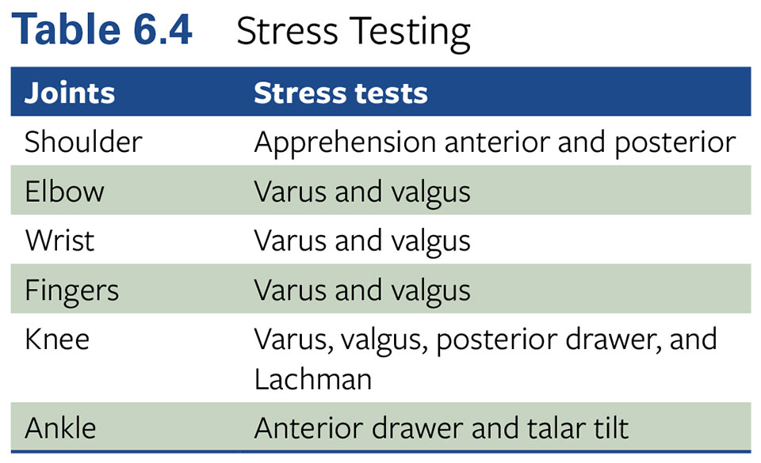
Joint Stability Testing
Each major joint should be tested for stability

Slide 14
Fitness Testing

Slide 15
Postural Alignment
Plumb line hung from the ceiling provides point of reference
Anterior, posterior, and lateral planes
Evaluate head, shoulders, hips, knees, and ankles for alignment

Slide 16
Ear, Nose, and Throat Assessment
Performed by a physician
Ear: otoscope to check for infection, obstruction, and hearing
Nose: nasal passages and ability to breathe
Throat: glands, teeth, infection, discoloration

Slide 17
Heart, Lungs, and Abdomen
Physician uses a stethoscope to listen
Heart: “lub dub” is normal; prolonged “swoosh” is not
Lungs: crackling, wheezing
Abdomen: bowel sounds

Slide 18
Neurological Assessment
Peripheral nervous system
Sensation and muscular movements
Pain, touch, and reflexes
Central nervous system
Brain: concussion testing
Computerized or sideline testing options

Slide 19
Checkout with the Physician
Reviews all of the tests completed at each station
Determines if further testing is needed
Postregistration
Medical information forms
Clears athlete for participation
Full clearance
Conditional restrictions

Slide 20
Summary
Preparticipation clearance is a critical step for all athletes
Needs to be performed annually and completed by sports medicine team
Team physician has the final authority to clear the athlete for participation

