Slide 1
Introduction to Anatomy
Chapter 7
Cartwright and Peer

Slide 2
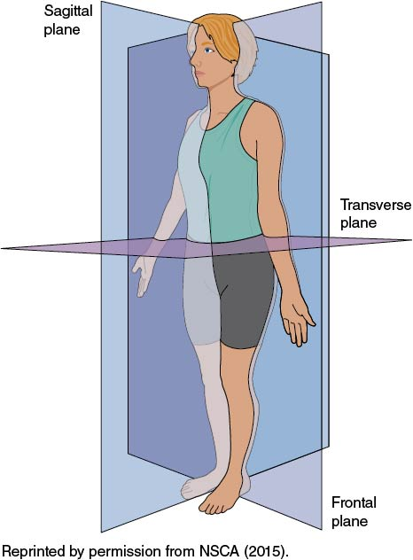
Anatomic Position and Planes
Anatomic position
Erect stance
Facing forward
Arms at side with palms facing forward
Anatomic planes
Frontal Sagittal Transverse

Slide 3
Commonly Used Anatomical Terms
Anterior = front of body
Posterior = back of body
Medial = toward the middle of the body
Lateral = toward the outside of the body

Slide 4
Body Tissues
Skin layers
Epidermis
Dermis
Hypodermis

Slide 5
Functions of Bones
Protect vital organs and structures from trauma
Skull
Ribs
Create stiff structure to promote movement through muscle action
Are metabolically active
Produce blood cells
Store minerals

Slide 6
Axial and Appendicular Skeleton
Axial skeleton
Spine
Thorax
Skull
Appendicular skeleton
Appendages or limbs

Slide 7
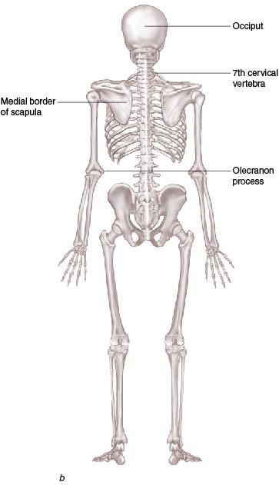
Bony Prominences
Areas of bone close to the surface of the skin
Malleoli
Patella
Anterior superior iliac spine
Olecranon process
Medial epicondyle of elbow
Medial clavicle
Occiput
Zygomatic arch

Slide 8
Muscles, Tendons, and Ligaments
Muscles
Create movement
Have origin and insertion
Supplied by nerves
Tendons
Connect muscle to bone
Ligaments
Connect bone to bone

Slide 9
Classification of Joints
Diarthrodial joints
Synovial joints
Joint capsule
Synovial membrane
Hyaline cartilage
Types
Hinge joints: elbow and knee
Multi-axial joints: shoulder and hip
(continued)

Slide 10
Classification of Joints (continued)
Amphiarthrodial
Cartilage connecting two bones together
Rib cartilage joining to the ribs
Synarthrodial joints
Fibrous joints
Immovable joints: tibia and fibula in lower leg

Slide 11
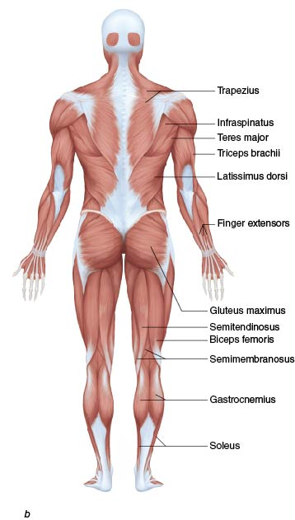
Movement
Muscles are the prime movers of the body
Muscles are named for location and action and shape

Slide 12
Muscle Tissue
Voluntary muscle tissue: Controlled by the person
Involuntary muscle tissue
Heart
Intestines
Blood vessels

Slide 13
Muscles
Prime movers = agonists
Opposite prime movers = antagonists
Examples: biceps in arm flexes (agonist) while the triceps relaxes to allow the movement (antagonist)
Synergists = muscles working together to cause the same action
Muscles have
Origins: typically proximal
Insertions: typically distal

Slide 14
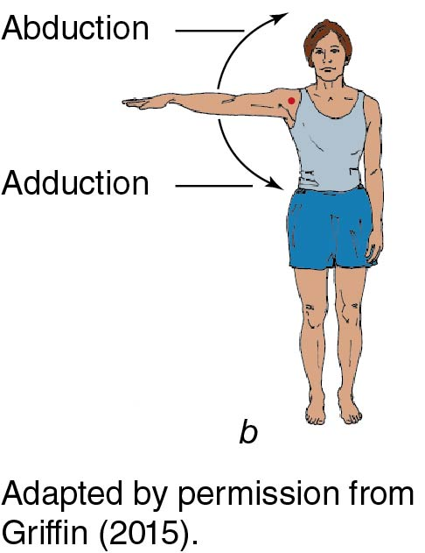
Muscle Movements
Flexion/extension
Abduction/adduction
(continued)

Slide 15
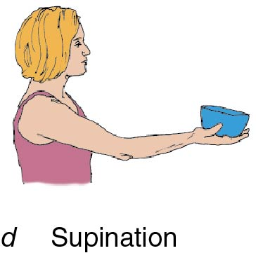
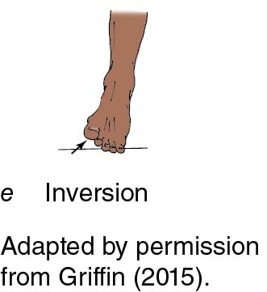
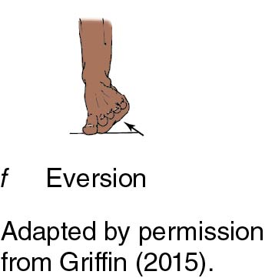
Muscle Movements (continued)
Pronation/supination
Inversion/eversion
(continued)

Slide 16
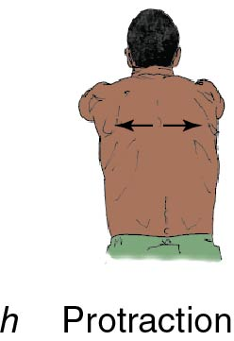
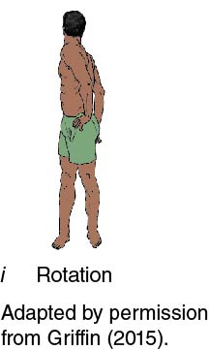
Muscle Movements (continued)
Protraction/retraction
Rotation
Elevation
(continued)

Slide 17
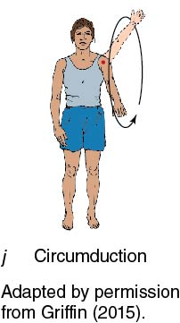
Muscle Movements (continued)
Opposition
Circumduction

Slide 18
Movement
Movement is a coordinated effort of bones, muscles, and other structures
Movement is often single planar but can also occur in multiple planes
Proper terminology regarding movement is important in order to communicate effectively in the healthcare settings

Slide 19
Summary
Anatomy and physiology are at the core of human movement and function
Understanding anatomical structures and how they work together is important for evaluation, treatment, and rehabilitation of injuries
The human body is complex in its composition and movements

