Slide 1
Stabilization and Transportation of Injured Athletes
Chapter 26
Cartwright and Peer

Slide 2
Extrication
Remove injured athletes from a playing area or dangerous situation in a safe manner
Always ensure it is safe for YOU to approach the situation: Don’t become a victim yourself
Many methods of transportation exist
Stabilize prior to moving if time permits

Slide 3
Equipment Removal
Not always necessary to remove equipment to treat an athlete
Face masks can be removed to access airway with helmets
Shoulder pads may need to be removed for CPR

Slide 4
Face Mask Removal
Two-person task
One removes the face mask
One holds the athlete’s head still
Tools
Screwdriver
Cutting tool
Practice, practice, practice

Slide 5
Shoulder Pads
Hockey and football
Can stay in place most of the time
Reach under them for evaluation
Side-lying removal is also permitted

Slide 6
Neck Roll
Depends on the type of neck roll
If attached by string, cut the string
If attached by screw, may consider keeping neck roll attached to shoulder pads for removal
If held in place by pressure of jersey, remove jersey

Slide 7
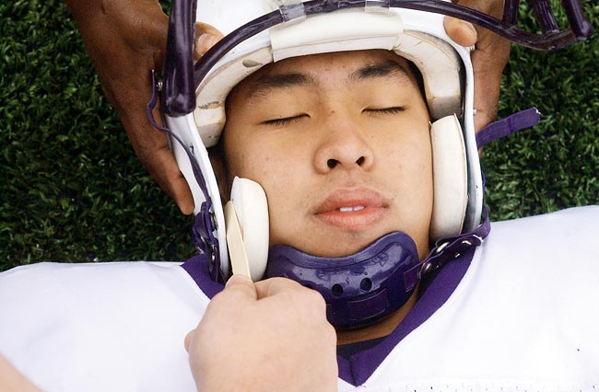
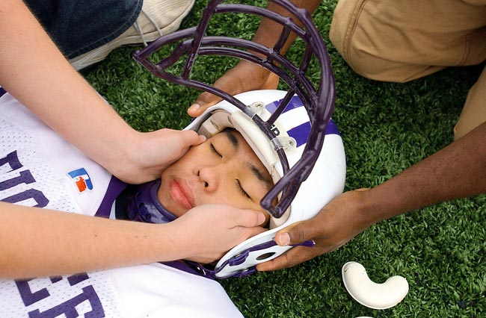
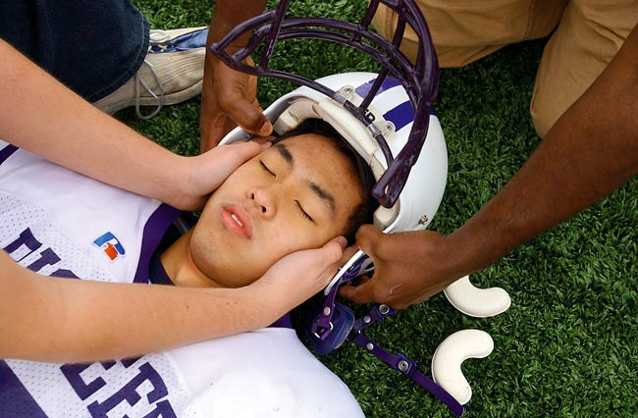
Helmet
Leave helmet on unless it interferes with care
Follow steps closely
Use extreme care not to move the cervical spine

Slide 8
Lifting and Moving an Athlete
Minor injuries: walk off alone or with assistance
Major injuries
Spine board
Stretcher
Golf cart

Slide 9
Splint Before Moving
In most cases, splint an injured area before moving the athlete
If danger is eminent, move athlete first by moving lengthwise to keep bone aligned with body

Slide 10
Carries for Removing an Injured Athlete
One-person carry
Seated carry
Two-person carry

Slide 11
Stretcher or Backboard
Stretcher is flexible
Non-spine injuries
General medical conditions
Logroll onto the stretcher or have athlete assist
Backboard is rigid
Spinal injuries
Logroll onto board with appropriate protocol

Slide 12
Specialized Stretchers
Scoop stretcher
Short board
Full-body vacuum splint

Slide 13
Backboard
Requires trained emergency personnel
Person in charge is at the head
Need at least 4 other people: logroll and carry
Alternate method: lift and slide

Slide 14
Summary
Transporting an injured athlete is an important skill
Determining whether to remove or retain the athelete’s equipment can impact the outcome of the injury situation
Understanding and practicing transportation skills is essential to providing optimal care in an emergency

