Slide 1
Reconditioning Programs
Chapter 21
Cartwright and Peer

Slide 2
Strength and Conditioning Principles
Progressive resistance exercise: Increase weight or number of repetitions during session and over time
Overload principle
In order to gain strength, a muscle must be pushed beyond the demands of the prior activity
Increase frequency, intensity, weight, type of exercise, length of workouts
(continued)

Slide 3
Strength and Conditioning Principles (continued)
Specificity of training
The body adapts to the specific demands placed upon it
Train for the activity you are performing
Be specific and be progressive

Slide 4
Types of Muscle Actions
Isotonic: Moving the joint through a range-of-motion with the same amount of weight
Shortening with resistance = concentric
Lengthening with resistance = eccentric
Isometric: Contraction with no joint movement
Isokinetic: Moving the joint at a fixed speed with variable resistance

Slide 5
Kinetic Chain Movements
Open kinetic chain
Distal part of the body is free-moving
Example: throwing a baseball
Closed kinetic chain
Distal part of the body is fixed or not moving
Example: push-up

Slide 6
Muscular Development Programs
DeLorme
PRE with ascending pyramid
Three sets in progressive manner
50% 10RM, 75% 10RM, 100% 10RM
Nautilus method
Perform all exercises until fatigue (1 set only)
(continued)

Slide 7
Muscular Development Programs (continued)
Pyramid method
Ascending and descending techniques
Ascending = DeLorme
Descending = Oxford
Bottom = constant set
Multiple sets

Slide 8
Muscular Endurance
Ability to perform repeated movements over time
Circuit training
Multiple stations (8-20)
All major muscle groups exercised
Rotate station to station for reps or time

Slide 9
Muscle Power
Ability to exert a force quickly
Explosive motions
Heavy weight for low reps

Slide 10
Joint Flexibility
Stretching
Static: holding a stretch for approximately 30 seconds
Ballistic: bouncing (not recommended)
Dynamic: move through full range-of-motion

Slide 11
Balance Exercises for Reconditioning
Balance is important
Use a variety of exercises on varied surfaces
Two legged vs one legged
Progressive

Slide 12
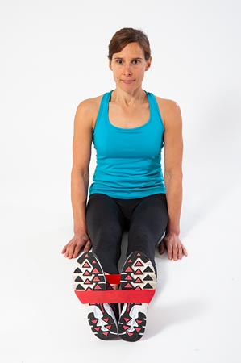
Exercises for Foot and Ankle

Slide 13
Exercises for the Knee, Hip, and Pelvis

Slide 14
Exercises for the Axial Skeleton
Use caution but be progressive
General flexibility and strength
Endurance is important
Use a variety of equipment
(continued)

Slide 15
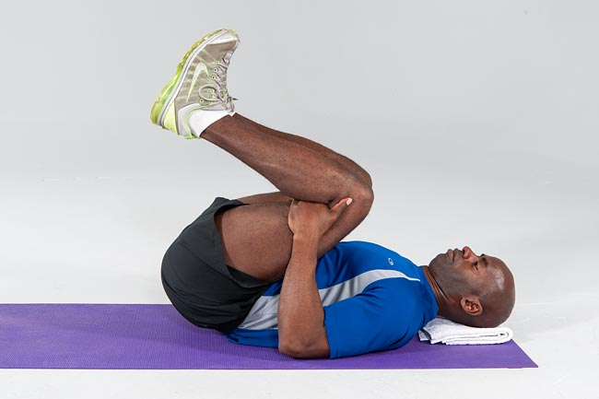
Exercises for Axial Skeleton

Slide 16
Cervical Programs
Strengthening and stretching
Shrugs are a great exercise
Resistive tubing is very helpful for most exercises
Focus on posture improvement

Slide 17
Reconditioning for Upper Quarter
Shoulder exercises
ROM
Wand exercises
Wall walking
Pendulum exercises
Strengthening
Rotator cuff
Scapular stabilizers

Slide 18
Elbow, Wrist, and Hand Reconditioning
Flexibility across two joints
Strength includes gripping
Squeeze racquetball
Sport-specific activity is important
Evaluate biomechanics of motion

Slide 19
Summary
Reconditioning requires that the athlete be placed in a progressive overload
Training should be sport-specific to reflect the loads of the sport
IMPRESS should be followed to ensure all components of rehabilitation are emphasized
Reconditioning is not just about the body part; it involves the whole body, including cardiorespiratory training

