Slide 1
Foot, Ankle, and Lower-Leg Injuries
Chapter 19
Cartwright and Peer

Slide 2
Anatomy
Bones and joints
28 bones in the foot
Phalanges (14)
Interphalangeal joints
Metatarsals (5)
Metatarsophalangeal joints
Midfoot
Talus and calcaneus

Slide 3
Anatomy (continued)
Ankle
Talus and calcaneus of foot, tibia, and fibula of lower leg
Medial malleolus: tibia
Lateral malleolus: fibula
Ligaments on the lateral and medial side for support

Slide 4
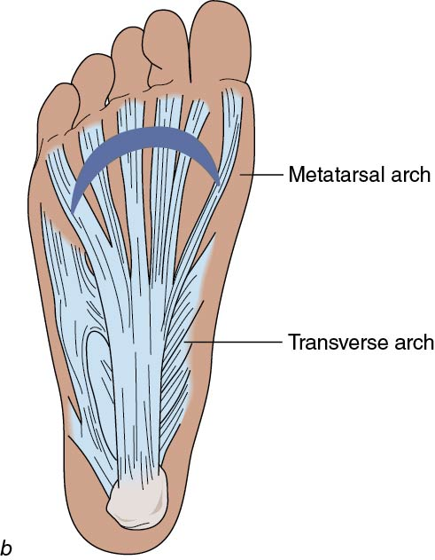
Arches of the Foot
Three arches on the plantar surface of the foot
Shock absorbers
Transverse
Longitudinal
Metatarsal

Slide 5
Muscles and Tendons
Peroneals
Lateral
Gastrocnemius & soleus
Posterior to Achilles tendon
Notes:
QQDE: That figure, depending on what it is, could be hard to read, even on a large screen. XXCE

Slide 6
Ligaments
Lateral ankle
Anterior talofibular
Posterior talofibular
Calcaneofibular
Medial ankle
Deltoid ligament

Slide 7
Preventing Foot, Ankle, and Lower Leg Injuries
Appropriate footwear
Supporting taping or braces
Protective equipment
Stretching and conditioning programs

Slide 8
Bone Injuries
Jones fracture
Fifth metatarsal
Inversion ankle sprain results in avulsion of the peroneus brevis
PRICES and refer
Usually requires casting

Slide 9
Epiphyseal and Stress Fractures
Epiphyseal fractures
Growth plates of the tibia and fibula
Plantar flexed and inversion mechanisms
Pain with walking and running
Refer to MD
Stress fractures
Repetitive stress: typically running
Tuning fork test
Bone scan
Rest for healing

Slide 10
Muscle and Tendon Injuries
Medial tibial stress syndrome
Inflammation to the medial tibial muscles
“Shin splints”
Tight calf muscles and may be out of shape
Usually have poor arch support
Achilles tendinitis
Jumping, running, and landing
May feel crunching or crepitus
Extreme case: Tendon may rupture and require surgery and lengthy recovery

Slide 11
Ligament Injuries
Great-toe sprain
Kicking, pushing off, and walking
PRICES and pad for return to play
Arch sprain
Usually metatarsal and longitudinal
Pain with running and walking
PRICES and arch pad and/or taping

Slide 12
Plantar Fascitis
Plantar surface of the foot has tough, fibrous band
Tenderness at calcaneus and moves toward toes
Heel cup, stretching Achilles, rest; orthotics if persistent
Heel spur may form
MD may need to intervene to decrease pain

Slide 13
Ankle Sprains
Graded: 1st, 2nd, and 3rd degree
PRICES and taping or bracing for return
Specific type
Syndesmotic - high ankle sprain
Usually with severe eversion or rotation
Takes a long time to heal

Slide 14
Ankle Dislocations
Anterior or posterior
Deformity and resistance to move the joint
Splint and call EMS
Major damage to nerves and vessels may result

Slide 15
Tissue Injuries
Contusions
Occur frequently
Wear protective equipment such as shin guards
Create pads to protect vulnerable areas

Slide 16
Toe Abnormalities
Hammertoes
Middle joint of toe is flexed, and metatarsal phalangeal and distal joint are hyperextended
Difficult to run and wear shoes
Callus formation
(continued)

Slide 17
Toe Abnormalities (continued)
Hallux valgus
Bunion
Excessive valgus stress on the great toe
Improperly fitting shoes: too tight

Slide 18
Anterior Compartment Syndrome
Anterior muscles enclosed in fascia
Pain like shin splints but actually bleeding inside increasing pressure that cannot release
Severe pain, red skin, loss of foot motion, hardness of tissue
Refer to MD immediately to prevent nerve damage

Slide 19
Summary
Foot, ankle, and lower leg injuries are common in sports
Most injuries respond well to PRICES and protection with padding, taping. or bracing
Strength and flexibility are important for all injuries to prevent further injury

