Slide 1
Wrist and Hand Injuries
Chapter 16
Cartwright and Peer

Slide 2
General Information
Wrist and hand injuries make up about 9% of all sports injuries
Many mechanisms of injury due to the many joints and bones in the area
Has very limiting impact on athletes, not just in sports but in activities of daily living

Slide 3
Wrist and Hand Anatomy
Bones
Hand: carpals, metacarpals, and phalanges
Scaphoid is important
5 metacarpals
14 phalanges
Joints
Named for bones they connect
Metacarpal phalangeal
Interphalangeal
(continued)

Slide 4
Wrist and Hand Anatomy (continued)
Muscles
Many complex motions at the wrist and hand
Extensor and flexor groups
Flexors = anterior surface of the forearm
Extensors = posterior surface of the forearm
(continued)

Slide 5
Wrist and Hand Anatomy (continued)
Ligaments
Many ligaments that hold the bones together
Wrist: stabilized by collateral ligaments medially and laterally
Transverse carpal ligament
Flexor retinaculum: anterior and holds flexor tendons and median nerve
Thumb
Ulnar collateral ligament: AKA medial collateral ligament
Radial collateral ligament: AKA lateral collateral ligament

Slide 6
Preventing Wrist and Hand Injuries
Protective equipment
Gloves, tape, braces, padding
Splints
Consider rules of the sport as the sport may prohibit certain types of protective equipment

Slide 7
Treating Wrist and Hand Injuries
Bone injuries
Direct impact
Pain, swelling, and deformity
Complications
Avascular necrosis: death of bone due to poor blood supply
Non-union: bone does not join back together well
Scaphoid fractures are vulnerable to these
(continued)

Slide 8
Treating Wrist and Hand Injuries (continued)
Boxer’s fracture
Fourth or fifth metacarpal fracture
Colles’ fracture
Distal forearm
Both radius and ulna fractured at the same time

Slide 9
Muscle and Tendon Injuries
Many chances of injury to muscle and tendons due to the sheer number of them in the wrist and hand
Usually ROM is affected
Watch the biomechanics of athlete’s movements
Usually repetitive motion is the cause
(continued)

Slide 10
Muscle and Tendon Injuries (continued)
Tendinitis
Prevent by increasing strength and flexibility, pad, and avoid repetitive motions
De Quervain’s tendinitis
Abductor pollicis longus and extensor pollicis brevis
Shot putters - wrist radial deviation with gripping an object
PRICES and rest
(continued)

Slide 11
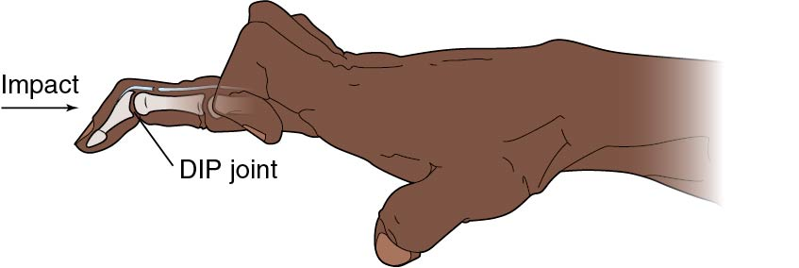
Muscle and Tendon Injuries (continued)
Mallet finger
Impact on finger tip
Rupture of the extensor tendon
Fingertip drops into flexion
Refer for splinting or surgery
(continued)

Slide 12
Muscle and Tendon Injuries (continued)
Jersey finger
Flexor tendon rupture
Unable to flex the DIP joint of the finger
Pain and swelling common
Splint, ice, and refer to MD for X-ray and possible surgery
(continued)

Slide 13
Muscle and Tendon Injuries (continued)
Boutonniere deformity
MOI = impact over PIP joint
Tears capsule
Unable to extend the PIP joint
Splint and refer to MD

Slide 14
Ligament Injuries
Wrist sprains
Common injury
Pain, decreased ROM, limited grip strength
PRICES
Tape or brace for return to play
(continued)

Slide 15
Ligament Injuries (continued)
Triangular fibrocartilage complex (TFCC)
Cartilage between ulna and carpal bones
Torn with forceful rotation or hyperextension
Immobilize and refer to MD
Dislocation of lunate
Falling with wrist flexed or extended
Deformity is classic
Splint and refer to MD
(continued)

Slide 16
Ligament Injuries (continued)
Gamekeeper’s thumb
Injury to the MCL of the thumb
AKA: skier’s thumb
Thumb forced into abduction
Splint and refer to MD
(continued)

Slide 17
Ligament Injuries (continued)
Interphalangeal collateral ligament sprains
Located on either side of the finger joints
Very vulnerable in sports
Usually painful and swollen
Ice
Refer if suspected fracture
Buddy tape for return to play
(continued)

Slide 18
Ligament Injuries (continued)
Dislocation of the interphalangeal or metacarpophalangeal joint
One bone moves dorsal, the other ventral
MD will reduce: YOU SHOULD NOT REDUCE THESE
Many blood vessels and nerves
Can cause major problems

Slide 19
Summary
There are many injuries to the wrist and hand
The complex structure and function of these structures make it very important to treat them carefully and promptly to prevent permanent loss of function
Sprains and strains are common
PRICES is the standard treatment with referral on any injuries you suspect need further evaluation

