Slide 1
Protective Taping and Wrapping
Chapter 27
Cartwright and Peer

Slide 2
Principles of Taping
Provide support and stability
Provide immediate first aid
Secure a pad or brace
Prevent injury
Restrict the angle of pull
Provide psychological assistance

Slide 3
Tape Selection
Linen
Elastic
Hybrid
Moleskin
Rigid

Slide 4
Kinesio Taping
Elastic tape
Used in sport, especially high profile sports
Takes pressure off underlying areas, allows ROM, decreases pain
Controversial in the literature relative to effectiveness

Slide 5
Selecting the Right Tape

Slide 6
Handling Tape
Smoothness and efficiency are important in tape application
Tearing the tape is a skill. Tear; don’t twist
Pull with appropriate tension as roll unwinds to prevent too much tension
Overlap by ½ width and angle with contour of body

Slide 7
Skin Preparation
Clean and dry skin
Ensure no allergies to adhesive or tape
Remove dirt and shave
Tape adhesive application
Foam pads at high friction areas
Apply underwrap in smooth fashion

Slide 8
Taping Techniques
Vary considerably from AT to AT
Find a standard technique and stay with it
Modify only to create an advantage

Slide 9
Ankle Taping
Closed and open basket weaves are standard
Anchor strips
Support strips (stirrups, horseshoes, heel locks, figure 8s)
Close with overlap of ½ width to prevent separation
Closure strips

Slide 10
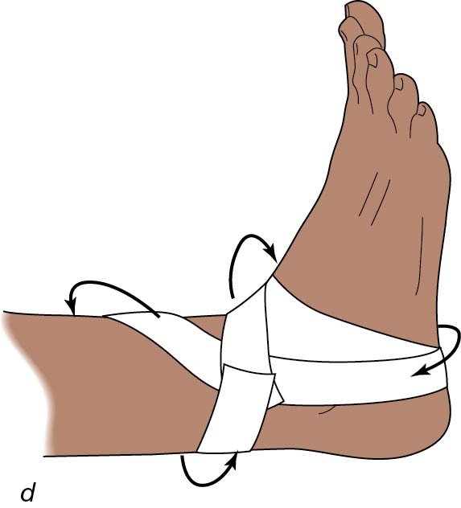
Ankle Tapings
Closed basket weave
Open basket weave

Slide 11
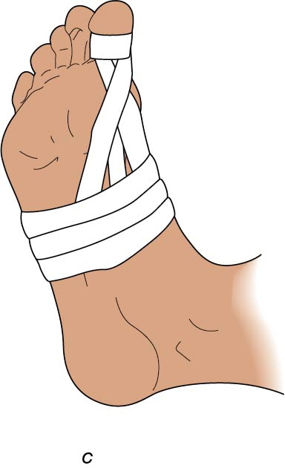
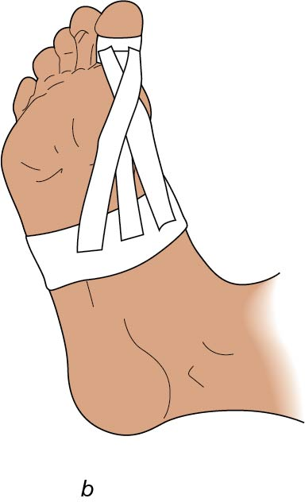
Turf Toe Taping
Restrict extension
Anchor at toe
3 strips to plantar aspect
Closure at toe and around midfoot
Watch for too tight binding
Elastic tape is a good option

Slide 12
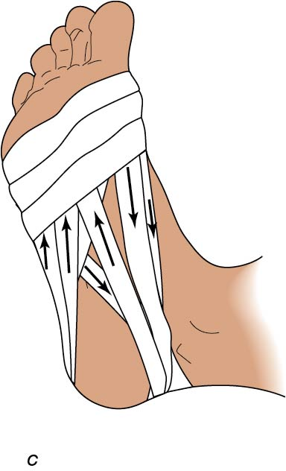
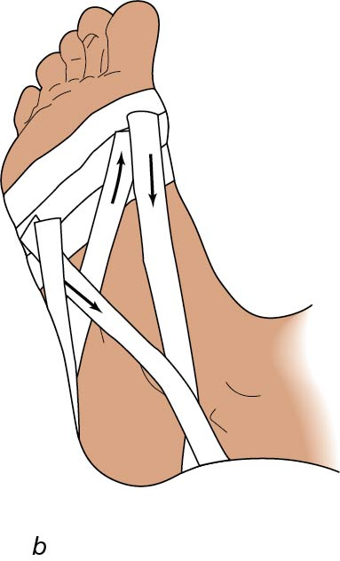
Longitudinal Arch
Anchor at ball of foot
Medial side of foot to around the heel and back to anchor
Repeat on lateral side
Use approximately 4-7 strips before closing

Slide 13
Achilles Tendon Taping
Restricts dorsiflexion
Patient is facedown (prone)
Anchor strips: midcalf and foot
Strips of elastic tape
Closure strips

Slide 14
Collateral Knee Ligament Taping
Anchor at midthigh and midcalf
Add fan to stabilize either side
Close with anchors and elastic wrap
Can place fan posteriorly for a hyperextension injury

Slide 15
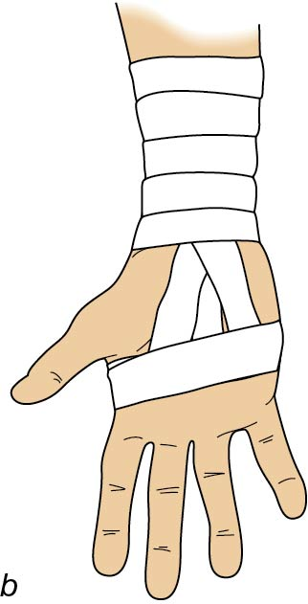
Elbow, Wrist, and Hand Hyperextension Taping
Similar to collateral ligament taping for knee
Anchor proximal and distal to the region
Create a fan to restrict motion
Close to ensure secure, non-slipping tape job

Slide 16
Elastic Wrapping Techniques
Provide compression and support
Washable, reusable, and cost-effective
Various widths for different injuries
Different lengths (single or double) to accommodate girth

Slide 17
Common tips
Begin distal and move proximal to move the swelling toward the heart.
Secure the wrap (dog-ear) as you begin to prevent slipping.
Apply smooth, even pressure and overlap to prevent gaps.
Secure with tape or clips.

Slide 18
Summary
Taping and wrapping are widely used skills for athletic training
Proficiency and efficiency are important because these skills are performed on many athletes
Understanding the anatomy and biomechanics of body parts helps to create effective taping procedures

